Slide 1
Mechanics
Design
Smart - Convenience - Comfortable

Slide 2
Scan
Body

Slide 3
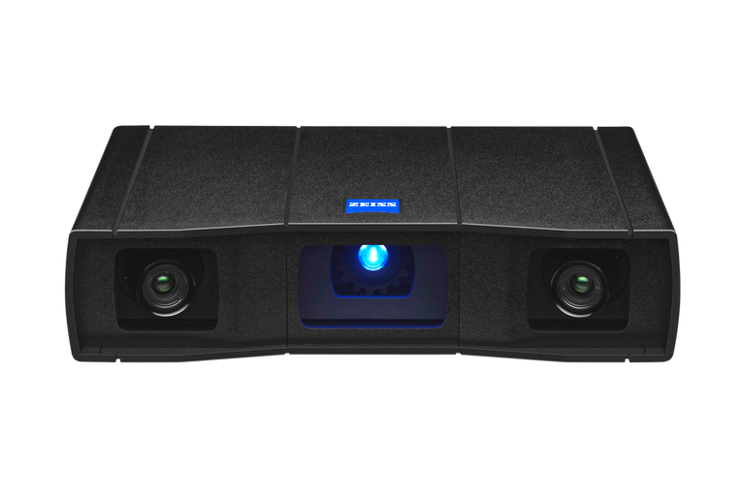
GOM SCAN 1

Slide 4
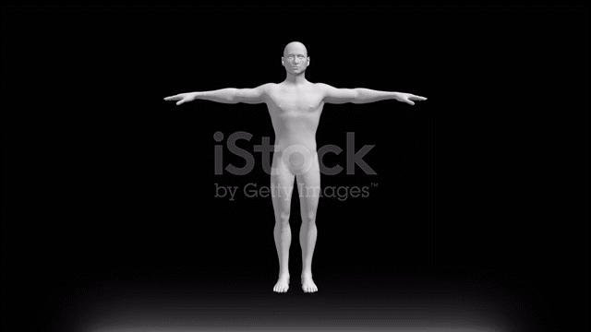

Slide 5
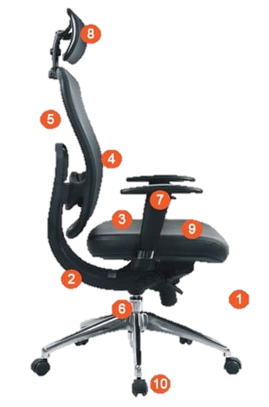
Headrest
Backrest recline
Backrest Lumbar support
Armrests
Seat tilt
Materials
Seat width and depth
Seat height
Swivel
Wheels

Slide 6

